Slide 1
RingWorld – the magnetic world of circles
Computational physics course first project work
Tobias Halfar

Slide 2
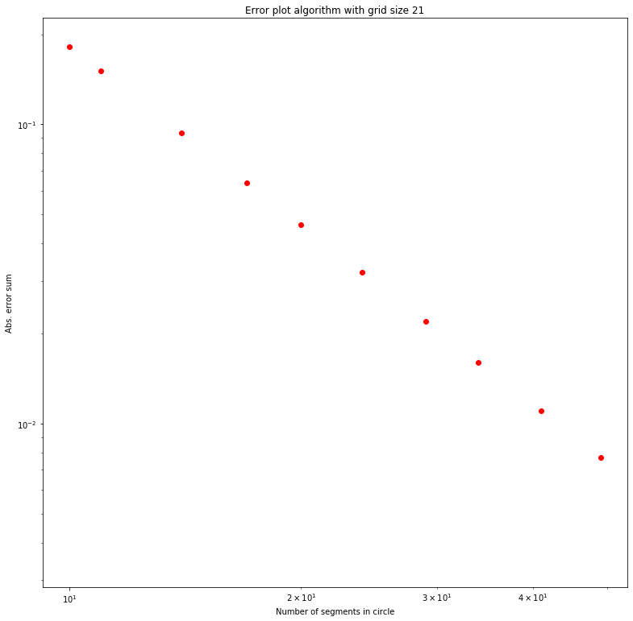
Algorithm validation
Its important to verify that used algorithm works!
One way to do this, is plot in logarithm scale how error behaves when elements number grows
If plot is linear, then error behaves polynomially as expected
In this case, error did behave polynomially so from this is observation deduction is that used algorithm is working
This element wise method is not very computationally effiecent

Slide 3
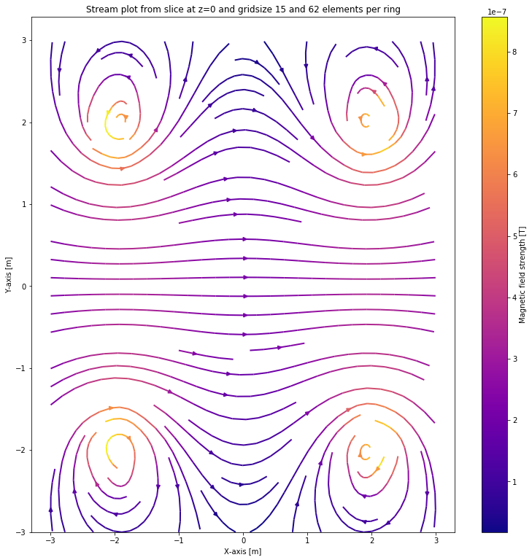
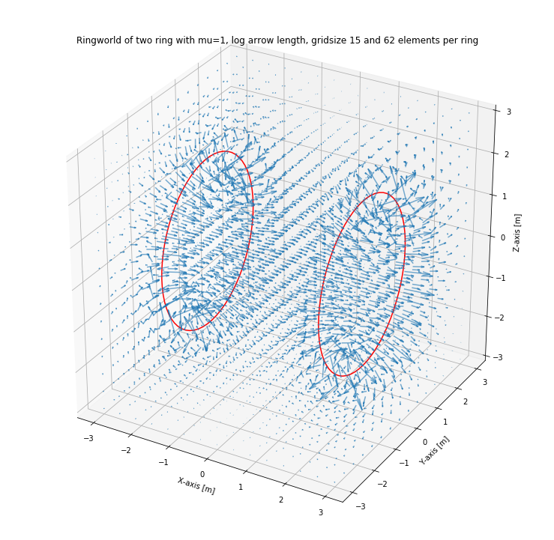
Two rings world
Used rings that composed of straight wire elements
Using two rings that have same current going through them
Results look like they should
Problem with 3D vector plot where arrow length is big near wire elements
Solved this using logarithm as scaling
Improvment would be using simpson rule or other instead of straight wire elements

Slide 4
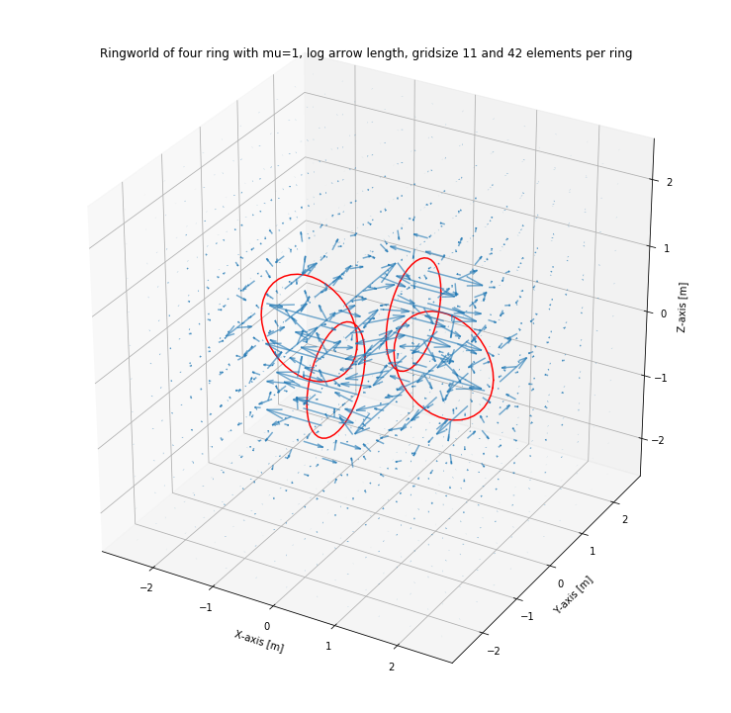
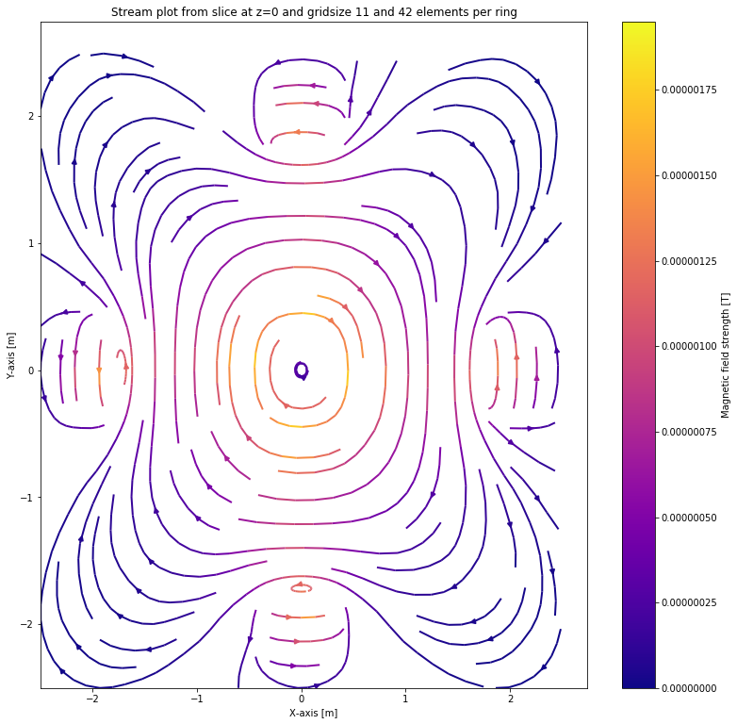
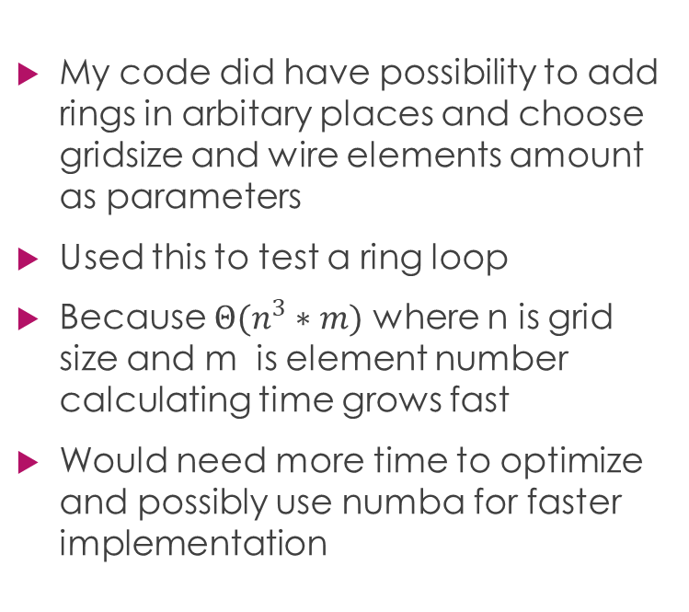
Four rings strengthening each other
My code did have possibility to add rings in arbitary places and choose gridsize and wire elements amount as parameters
Used this to test a ring loop
Because $Θ(n^{3}∗m)$ where n is grid size and m is element number calculating time grows fast
Would need more time to optimize and possibly use numba for faster implementation

Slide 5
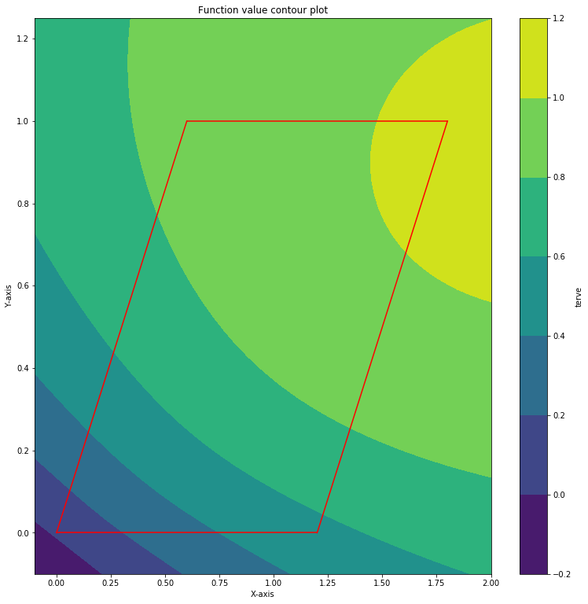
Alpha space integral
Used alphaspace to transfer the integral in straight coordinate system
Algorithm did have some systematic error, because about 1% error persisted for which grid size increase did not make better accuracy
Should have done earlier, time limit was up.

